Slide 1
Mission Statement & Objective
Objective #3
To search alumni as per skills for referrals
Objective #2
To search alumni, contact and job details for referrals
Objective #4
To track the alumni who attended the events
Mission Statement
To collate information about alumni of R. H Smith School of Business’s for student’s and school’s reference
Objective #1
To track donations made by alumni as per month and year
Objective #5
To gather information about the skills trending in the industry

Slide 2
Business Transactions

Slide 3
Business Transaction 1
What are the Current job details and Linkedin contact Details of an Alumni?
Select concat(a.firstName,' ',a.lastName) fullName,b.jobRole,b.companyName,c.contactDetails from [smith.alumni] a,[Smith.Contacts] c,[Smith.Jobs] b
where a.alumniId=b.alumniId and a.alumniId=c.alumniId and (c.contactType='Linkedin' or c.contactType='linkedin') and (yearEnd='Present' or yearEnd='present');

Slide 4
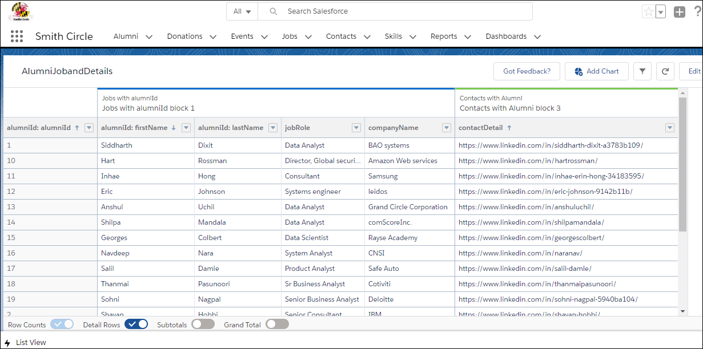

Slide 5
Business Transaction 2
What is a total amount donated to Smith by it’s Alumni per their batch?
select b.batch,sum(a.amountDonated)totalamount from [smith.donation] a, [smith.alumni] b where a.alumniId=b.alumniId group by b.batch order by totalamount desc;

Slide 6
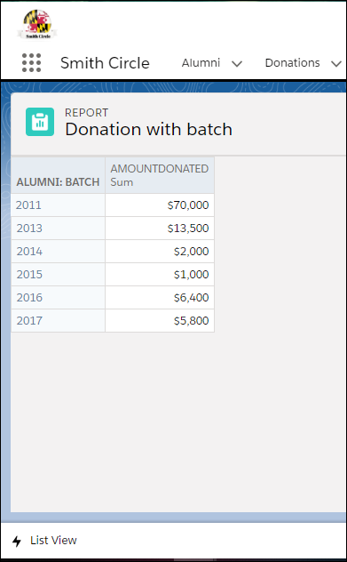
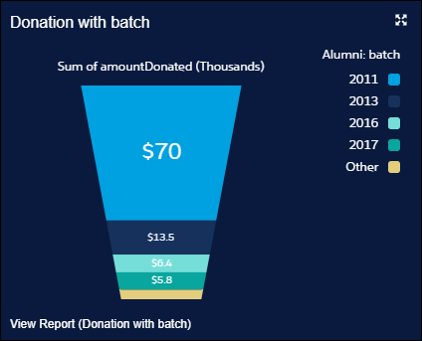

Slide 7
Business Transaction 3
What is count of alumni working per city?
select baselocation,count(alumniId) AlumniPercity from [smith.jobs] where yearEnd in ('Present','present') group by baseLocation order by AlumniPercity desc;

Slide 8
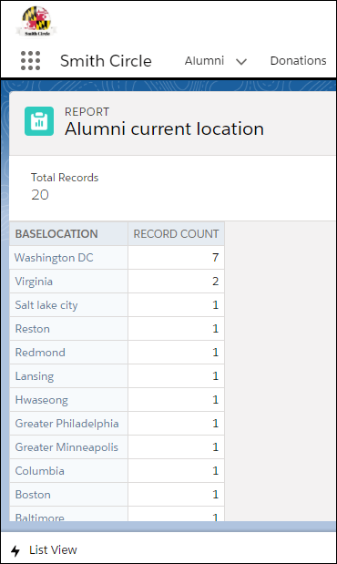
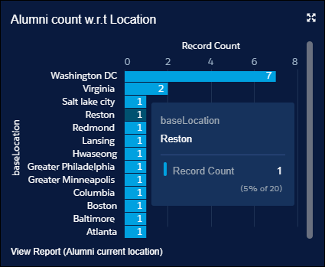

Slide 9
Business Transaction 4
How much grant does Smith school recieves from it's Alumni every Year?
Select yearDonation,sum(amountDonated) totalDonation from [Smith.Donation] group by yearDonation order by yearDonation asc;

Slide 10
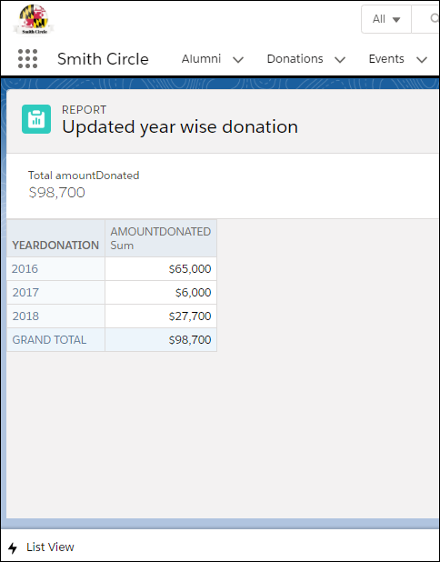
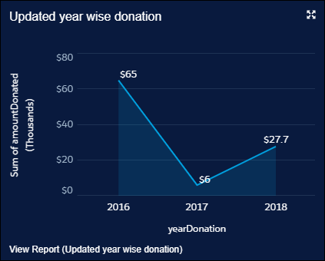

Slide 11
Business Transaction 5
What are the most popular Skills that MSIS students have?
select skillName from [smith.skills] a, (select count(alumniId) skillperalumni, skillId from [smith.acquired] group by skillId )b where a.skillId=b.skillId order by skillperalumni desc

Slide 12
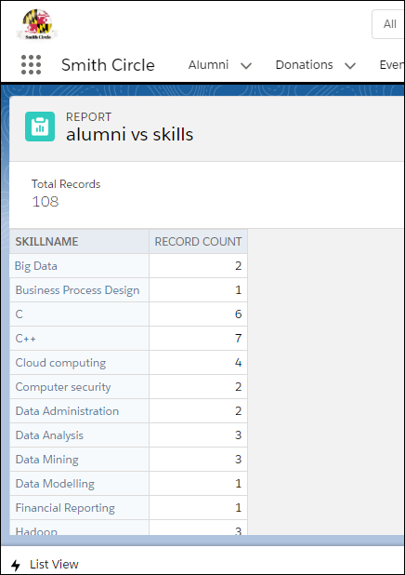
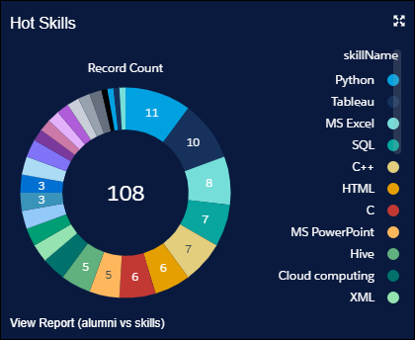

Slide 13
Business Transaction 6
Which Alumni are attending the events?
Select a.firstName,a.lastName fullName ,c.eventName,c.eventYear from [smith.alumni] a, (select x.eventName,x.eventYear,y.alumniId from [smith.events] x,[Smith.Attends] y where x.eventId=y.eventId )c where a.alumniId=c.alumniId order by eventYear;

Slide 14
